Slide 1














Final Project
Presented by Group 7
Nguyễn Công Tuấn-2101040201
Vũ Thị Hường- 2101040100
Mai Hồng Hạnh-2101040082
Nguyễn Đức Toàn-2001040206
Vũ Đặng Anh Quân-2001040172

Slide 2
Table of content
03.
Library Used
Code Structure
01.
Introduction
04.
Main functions
02.
Interface
05.

Slide 3

Origin of the creative idea
The idea for the Timetable Scheduler emerged from the pressing challenges faced by educational institutions in managing schedules efficiently. Traditional manual scheduling methods are often labor-intensive and error-prone, leading to frequent conflicts and inefficiencies.

Slide 4
Key Inspirations
01
02
03
04
Pain Points in Manual Scheduling:
Time-consuming processes
High likelihood of human error
Difficulty in managing recurring events and avoiding overlaps
Need for Automation:
Automating the scheduling process reduces workload
Ensures accuracy and conflict prevention
Java Swing and User Experience:
Java Swing was chosen for creating an intuitive and adaptable graphical interface
Aimed at making scheduling accessible even for non-technical users
Room for Future Expansion:
Potential to integrate advanced features like room reservations and detailed lesson planning
Focus on creating a scalable solution adaptable to evolving educational needs

Slide 5
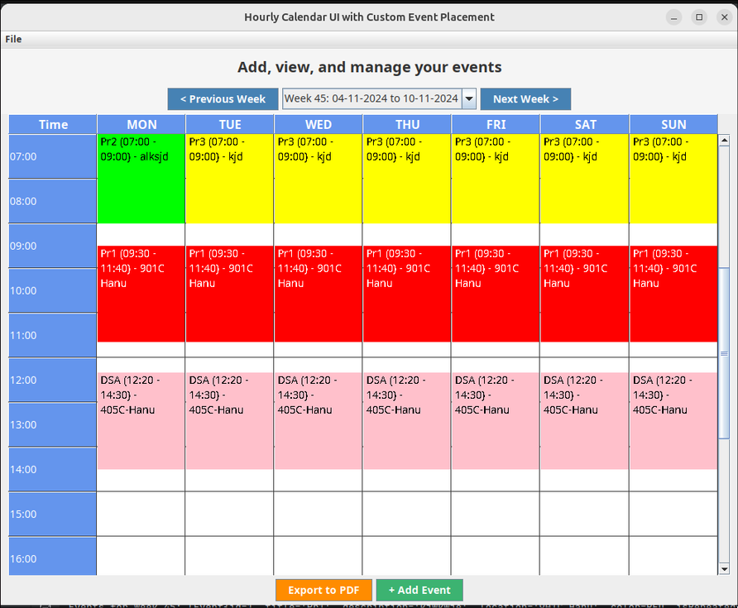
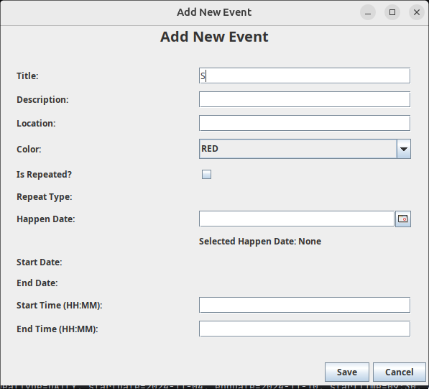
Interface

Slide 6
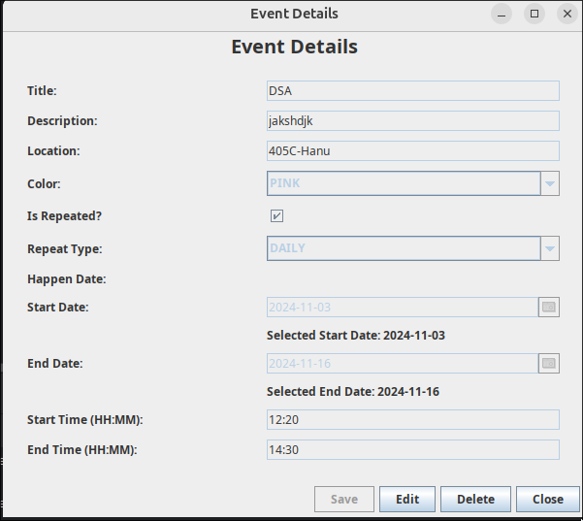
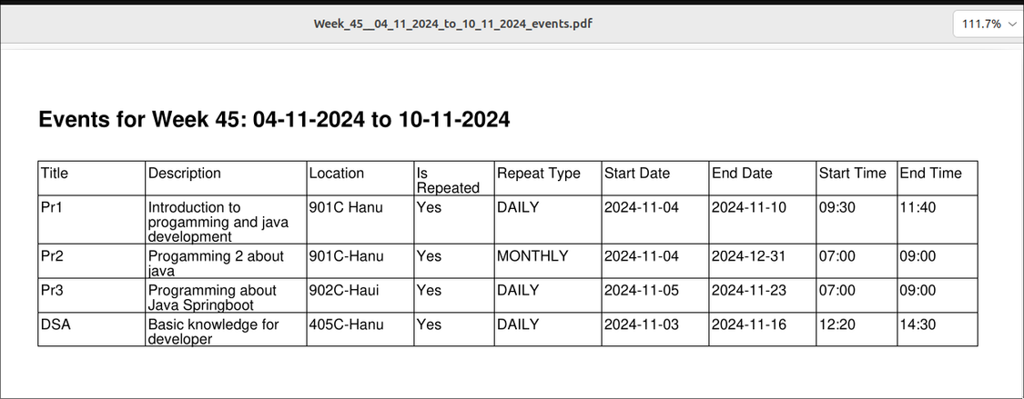
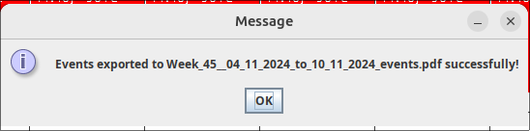
Interface

Slide 7

ADDITION LIBRARY USED
MySQL Connector
Facilitates seamless interaction between the Java application and the MySQL database.
Enables efficient storage and retrieval of timetable data, ensuring data integrity and smooth operation.
JCalendar
Provides a user-friendly graphical interface for date selection.
Enhances usability by allowing quick and intuitive date selection, reducing manual input errors.
iText PDF Library
Enables the creation and manipulation of PDF documents.
Essential for generating reports and exporting timetables in a professional PDF format, ensuring flexibility and high-quality document output.

Slide 8

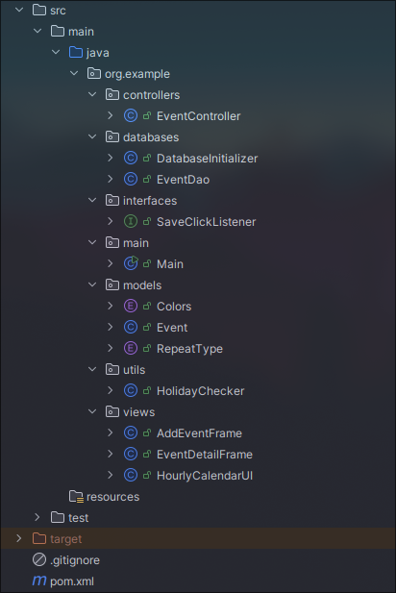
CODE STRUCTURE
Model
EventDao.java: Handles CRUD operations for managing events in the MySQL database using JDBC.
DatabaseInitializer.java: Manages database connection setup and ensures proper data structure for timetable storage.
View
HourlyCalendarUI.java: Displays the calendar view in an hourly format, allowing users to visualize their schedules and detect conflicts.
EventDetailFrame.java: Provides detailed information about specific events, such as start time, end time, and location.
AddEventFrame.java: User-friendly interface for adding new events, ensuring intuitive interaction and ease of use.
Controller
EventController.java: Acts as the intermediary between the Model and the View, managing data flow, validating user input, and updating the database. It ensures seamless communication between the user interface and the underlying data logic.

Slide 9
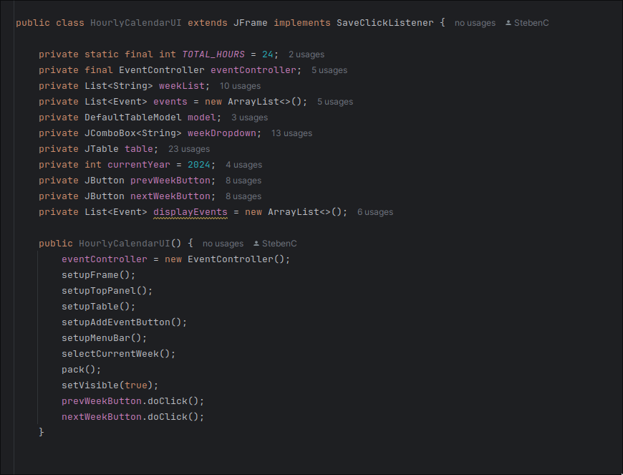
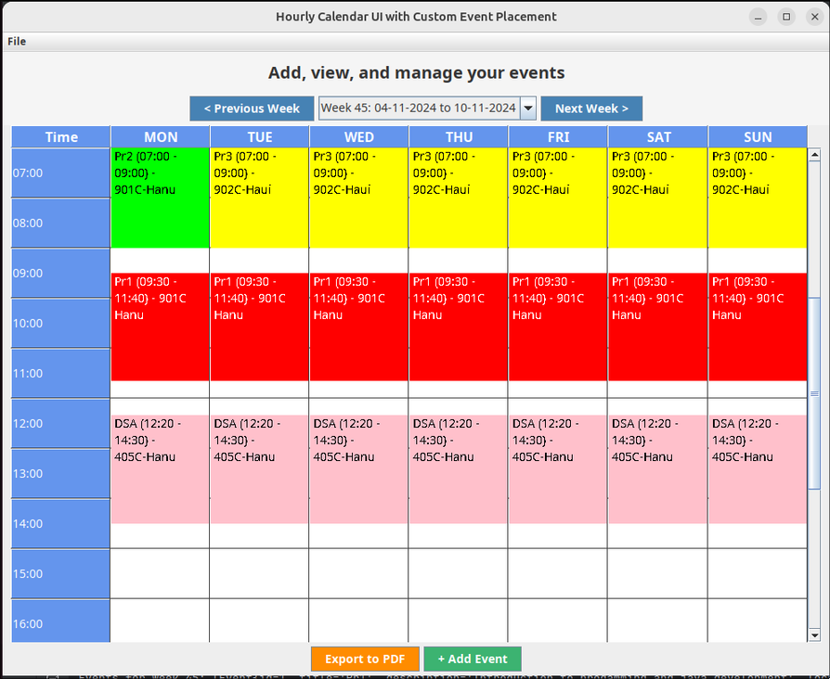
MAIN FUNCTION: VIEW
Main Screen
Main screen to interact with the app.
View event, navigate between weeks.
Constructor to set up and create view.

Slide 10
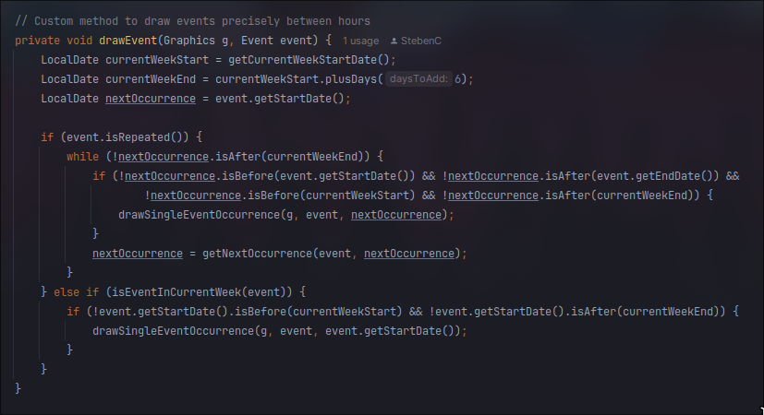
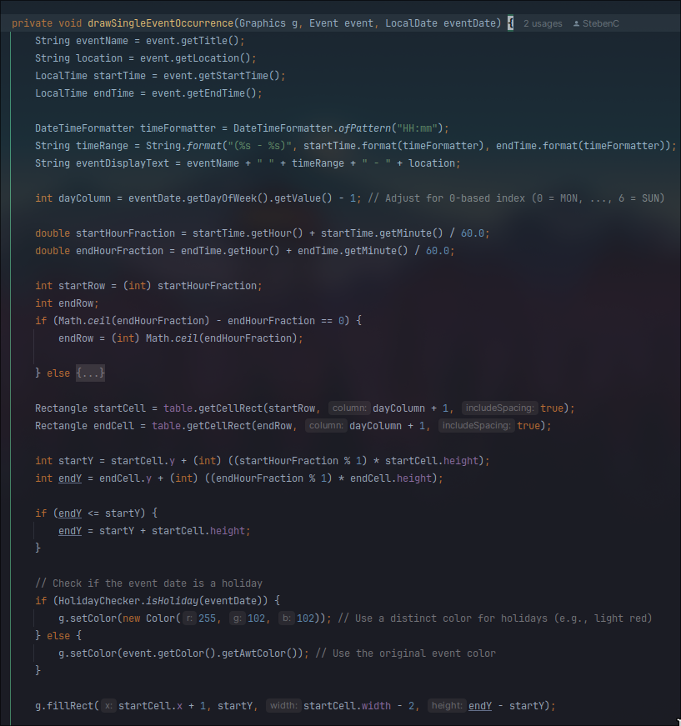
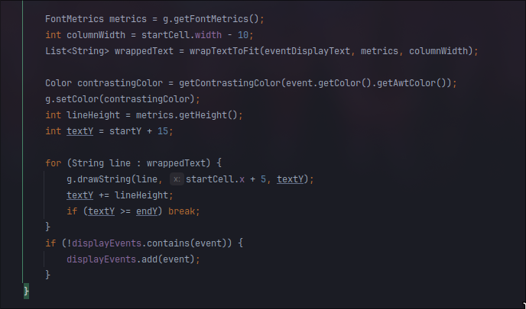
MAIN FUNCTION: VIEW
Drawing function
Custom drawing function that helps to draw events on the table base on the type of repeat, date and time of event: calculate endRow and startRow to display

Slide 11
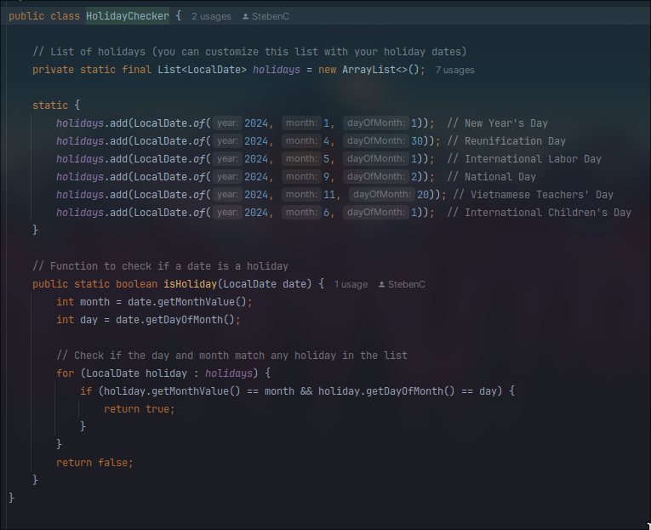
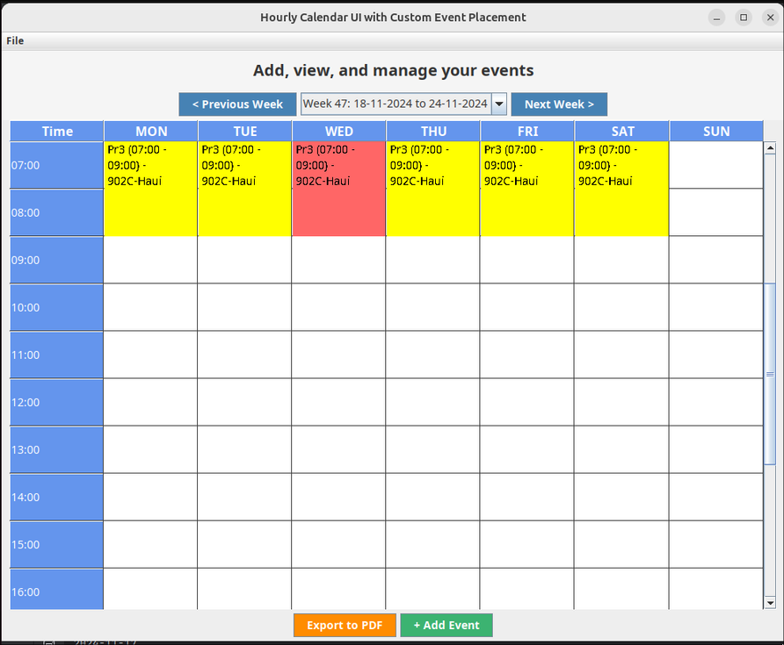
MAIN FUNCTION: VIEW
Helper Holiday checker
Check the current date is the holiday or not. Work with the drawing function to draw the event differently to help user easy to define.

Slide 12
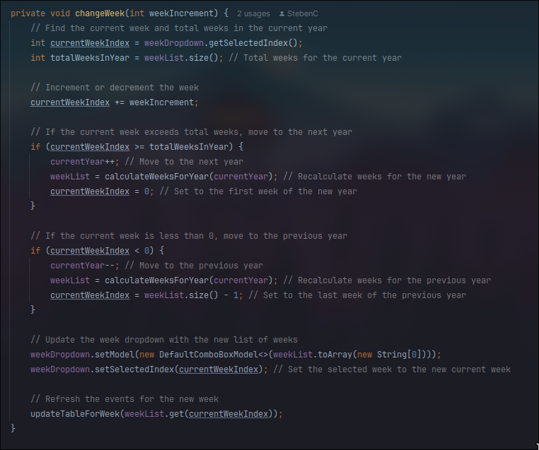
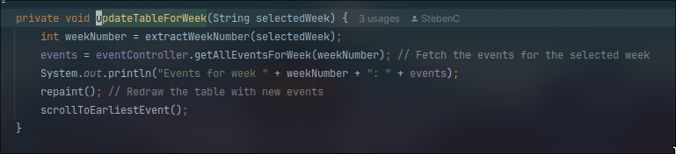
MAIN FUNCTION: VIEW
Function to change week
By changing the week and load new data from database and also auto scroll to the earlier event to make UI friendly for user

Slide 13
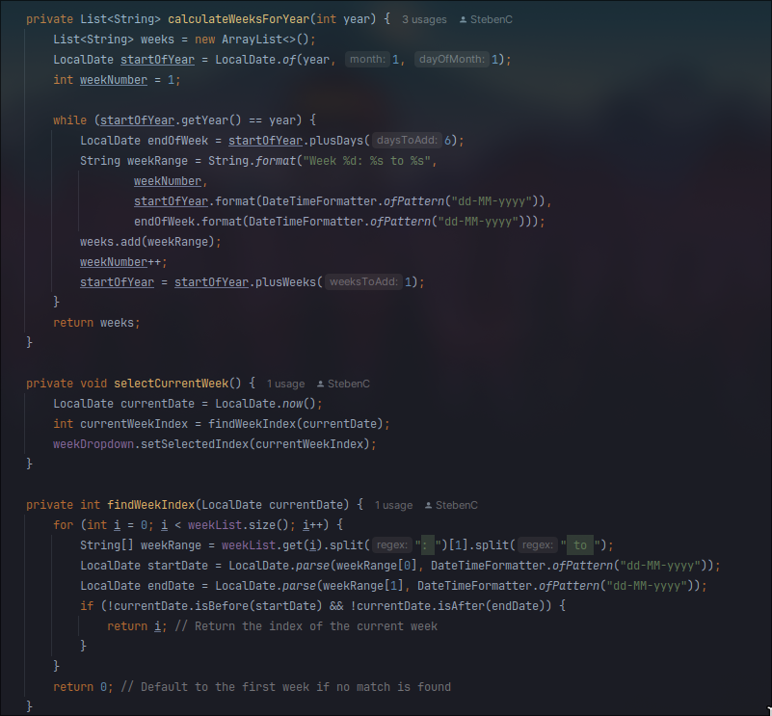
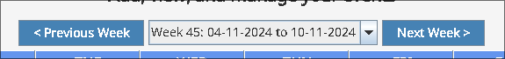
MAIN FUNCTION: VIEW
Weekly Selection Functionality
The code automates week selection by generating week ranges for a given year, formatting them as "Week X: start to end," and using LocalDate for accurate date handling. It then identifies and selects the current week in the dropdown, ensuring a seamless and user-friendly experience.

Slide 14
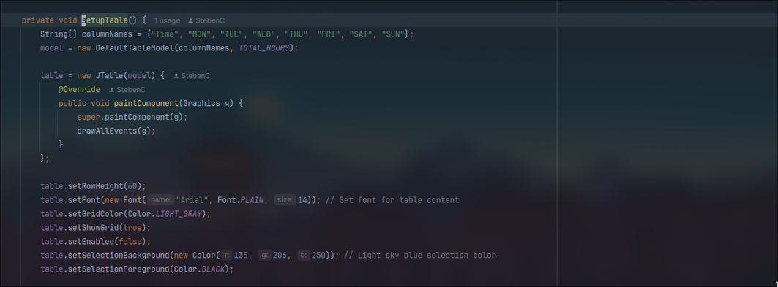
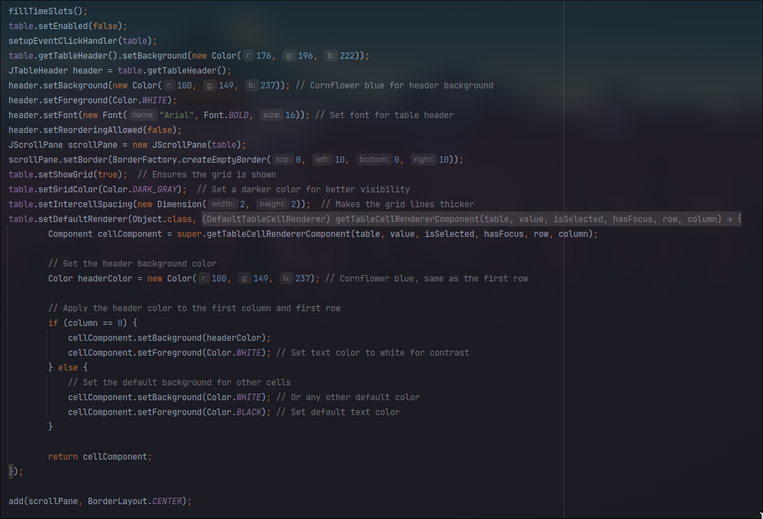
MAIN FUNCTION: VIEW
Setup Scrollable Table
The setupTable method creates a styled weekly schedule table with time slots and days of the week. It customizes fonts, colors, and grid settings, highlights headers and the first column, and wraps the table in a JScrollPane for easy navigation, ensuring a clear and user-friendly interface.

Slide 15
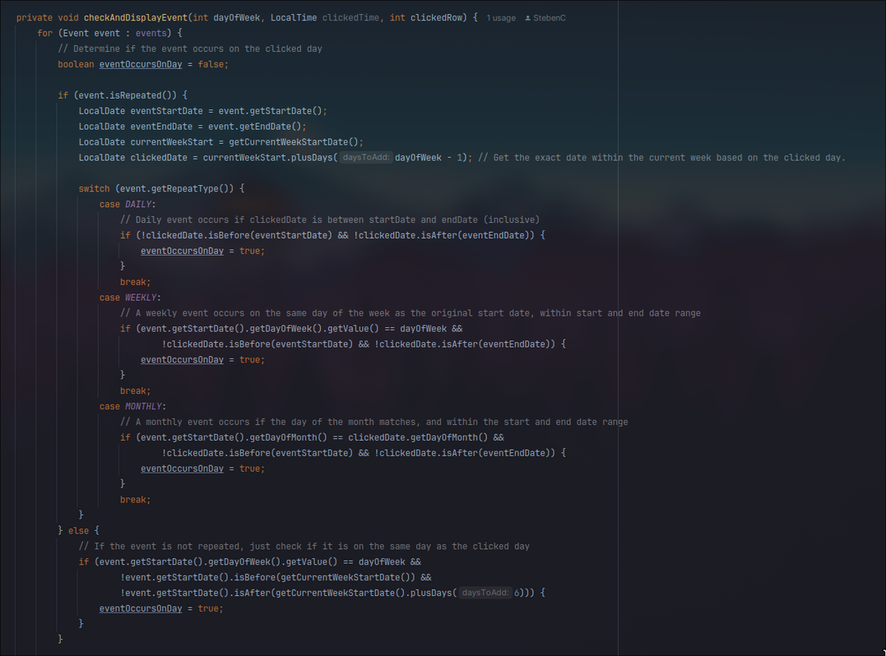
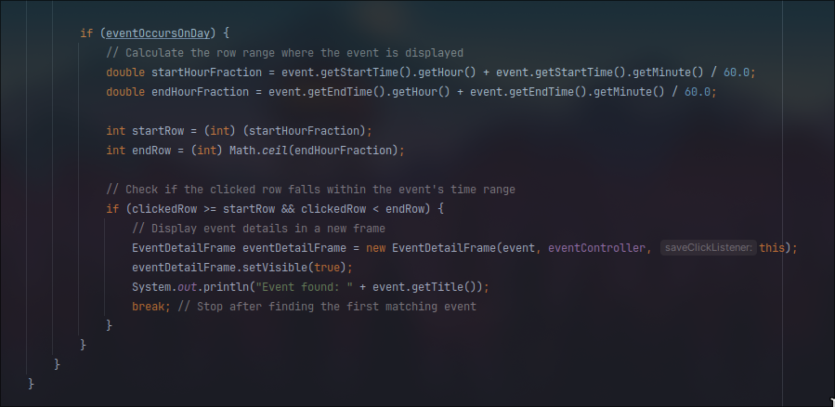
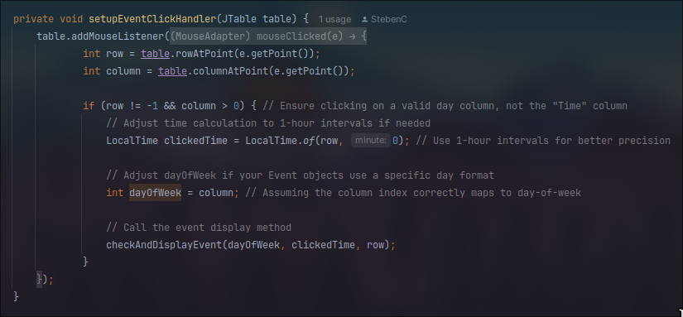
MAIN FUNCTION
Handle click on event
By calculate the pointing of user to the cell of table, and check the events list of week and check on which event was point to and display the detail of the event.

Slide 16
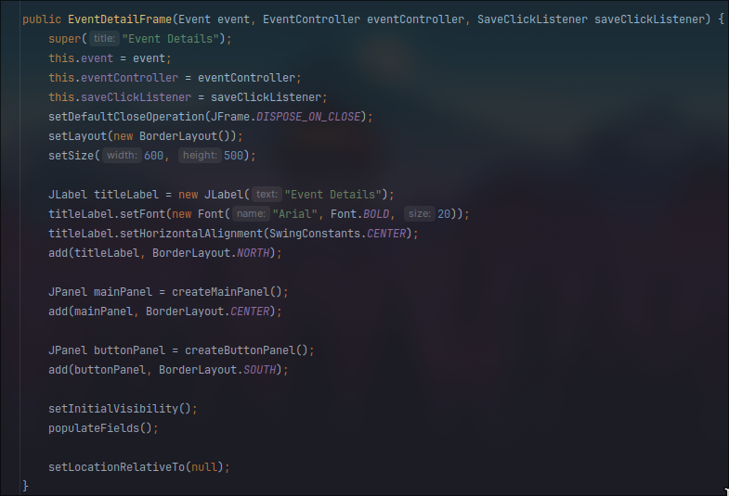
MAIN FUNCTION: VIEW
Event Detail Frame Constructor
The constructor to make export detail of event to user

Slide 17
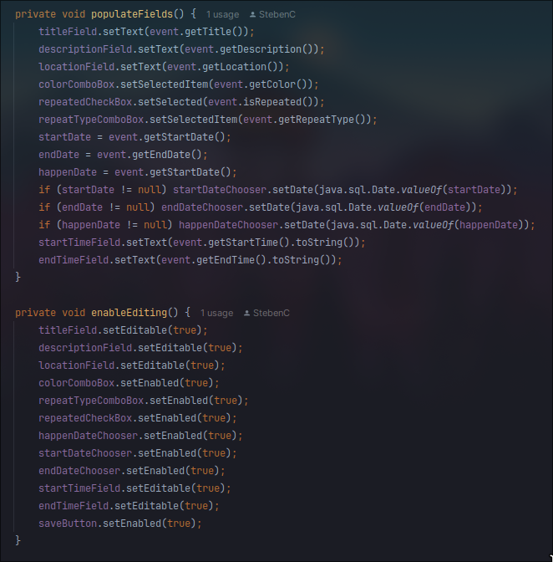
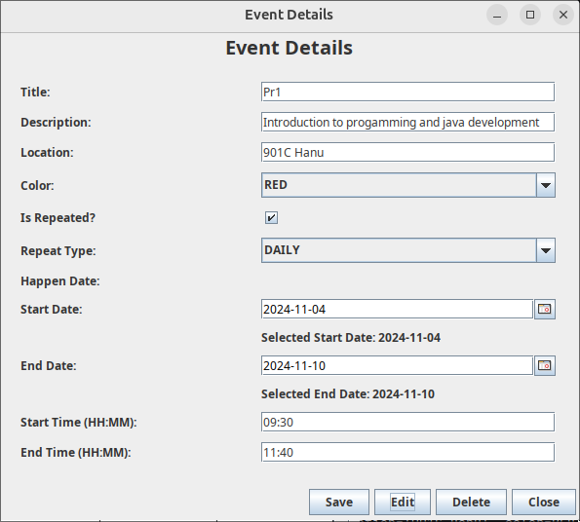
MAIN FUNCTION
Function to Toggle Edit and Bind Data
Logic to bind and toggle text field for user can edit the detail of event.

Slide 18
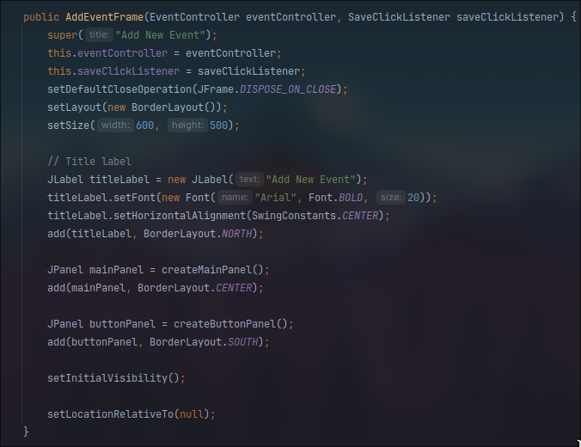
MAIN FUNCTION: VIEW
Add new Event Frame Constructor
Constructor to draw all components for this screen.

Slide 19
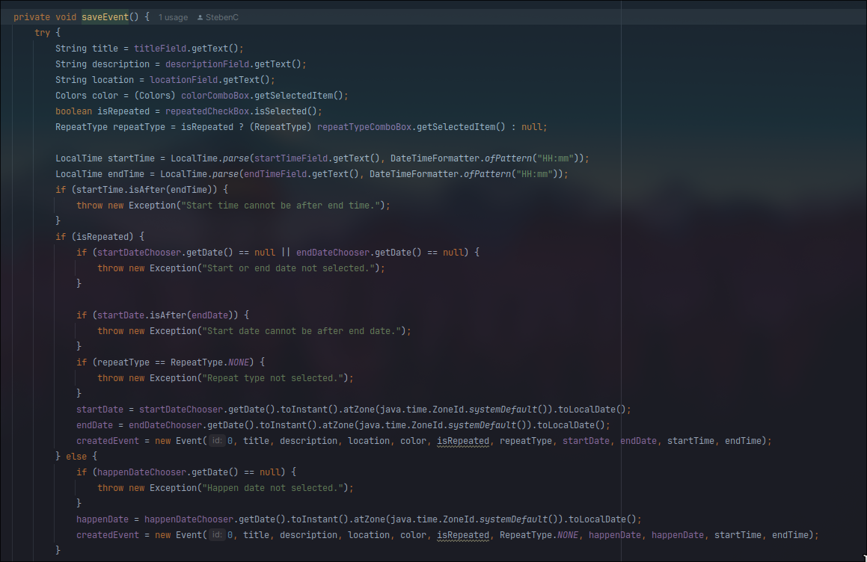
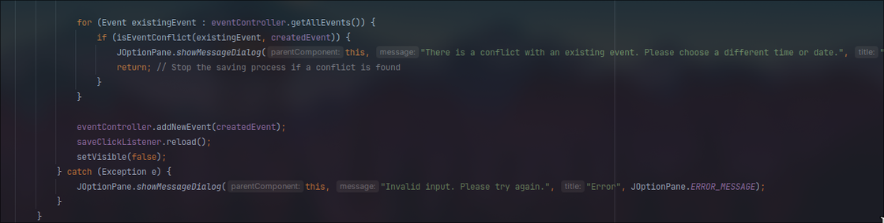
MAIN FUNCTION: VIEW
Save Event function
By using brute-force algorithm to detect the current is overlap to other events, the program will notice user the conflict and make them change the time to fit the time table

Slide 20
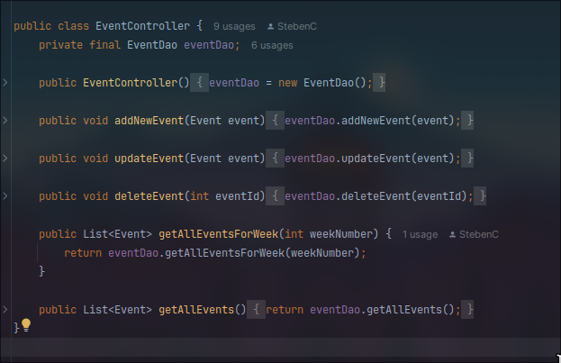
MAIN FUNCTION: CONTROLLER
EventController
The EventController class manages event operations, interacting with EventDao to add, update, or delete events. It provides methods to fetch all events or filter events for a specific week, acting as a bridge between the application's data layer and user interface for efficient event management.

Slide 21
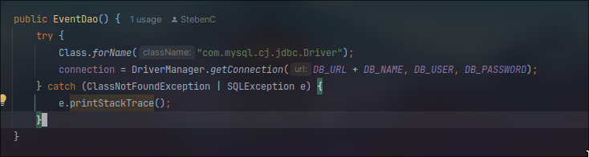
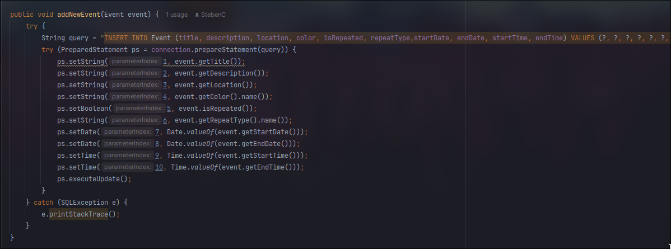
MAIN FUNCTION: CONTROLLER
Main interact with database when it ready
Connect to the database in constructor.
Add new event in database.

Slide 22
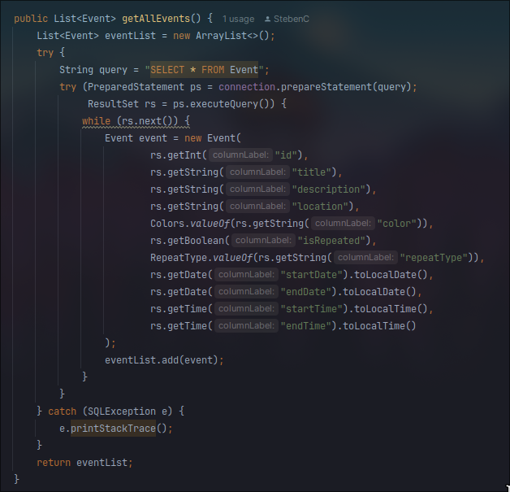
MAIN FUNCTION: CONTROLLER
Main interact with database when it ready
Take out all event in database.

Slide 23
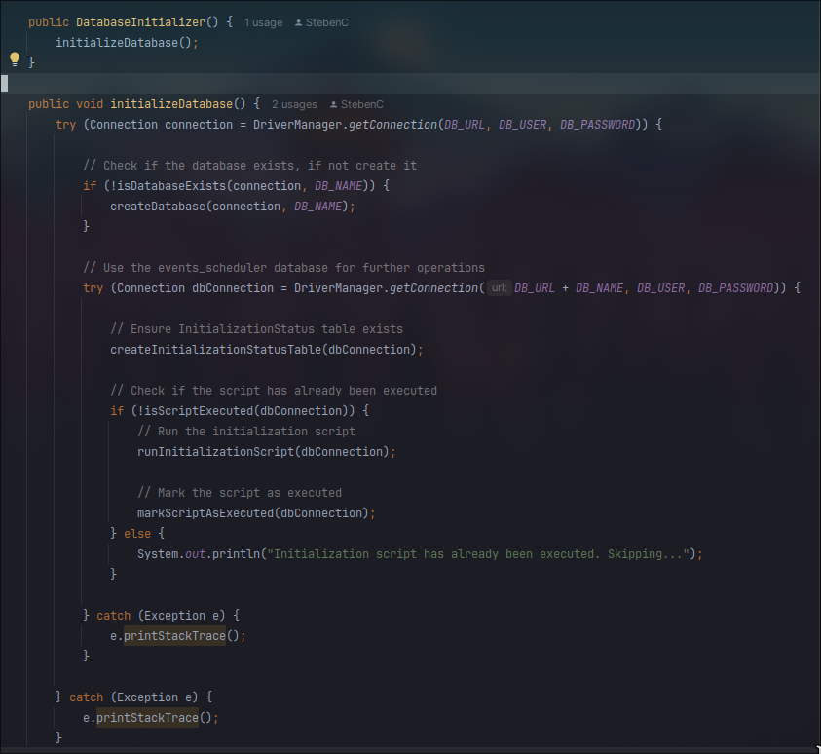
MAIN FUNCTION: CONTROLLER
Database setup
When app run, it will auto run script to check database, if database not available, it will create new database to match requirement.

Slide 24
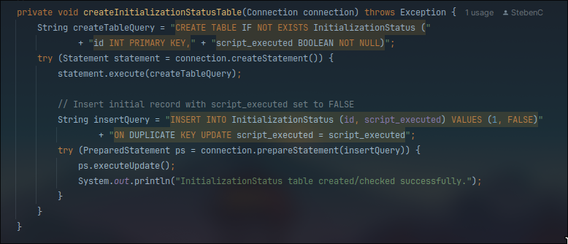
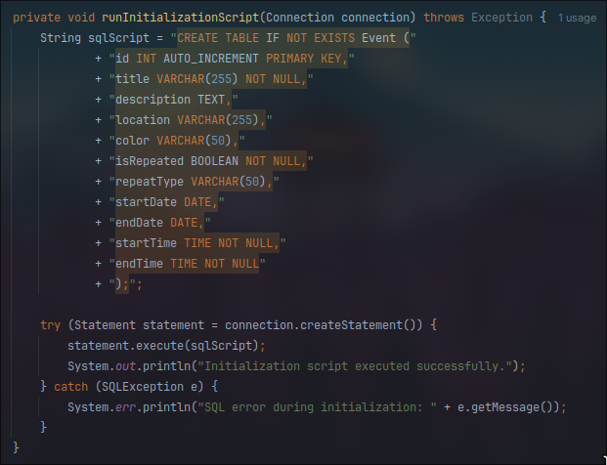
MAIN FUNCTION: CONTROLLER
Database initialize script: DatabaseInitializer
Script to create 2 table through JDBC:
Table InitializationStatus to store status of database.
Table Event to store all event in calendar.

Slide 25
MAIN FUNCTION: CONTROLLER
Main interact with database when it ready
Take out all event base on the week:
by filer all event by start, end date and consider to RepeatType: Daily, Monthly or Weekly

Slide 26
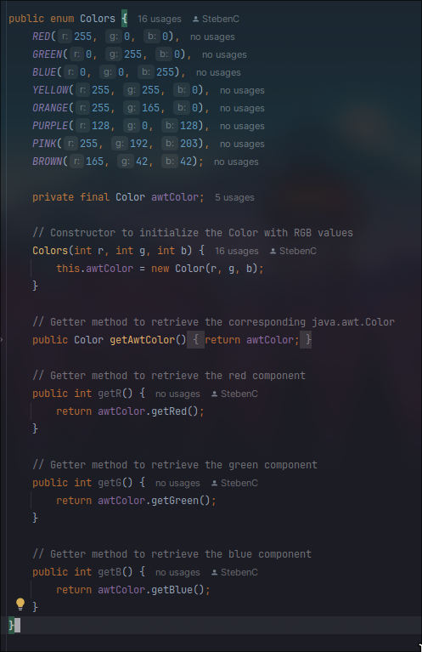
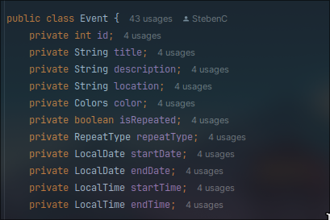
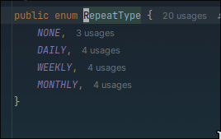
MAIN FUNCTION: MODEL
Model
How It Works:
The Event class models event details, including recurrence patterns and visual representation.
Uses Colors enum to assign event colors with RGB values for easy visual identification.
Implements RepeatType enum to support different event repetition types (e.g., Daily, Weekly).
Effectiveness:
Efficient Event Handling: Simplifies scheduling with structured attributes and built-in recurrence options.
Enhanced User Experience: Color coding makes events easily distinguishable.
Flexible Recurrence: Supports various repetition frequencies, catering to diverse scheduling needs.

Slide 27
Thank you very much!

